Slide 1
Java team project Tank war(game)
design by: Anita Mirshahi & Qian gao

Slide 2
description of Game
This is a 2D game designed for all gender and age groups.
Anyone who opted in will benefit the enjoy of playing an action game as well as improving the attention, mood, cognitive, strengths.

Slide 3

Main features & functionalities

Slide 4
Challenges:
Movements of the tank
Collision detection
Save game
Shooting bullets
Multiple players & enemies

Slide 5
Solutions and technologies:
Graphics in AWT and Swing
KeyEvent
Database using SQLite
Multiple Threading

Slide 6
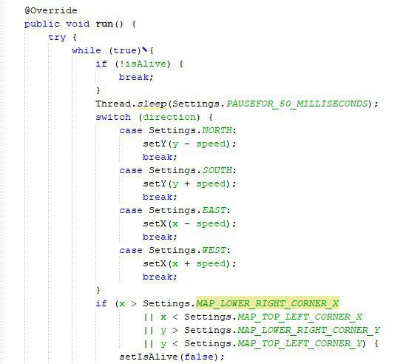
Code:

Slide 7
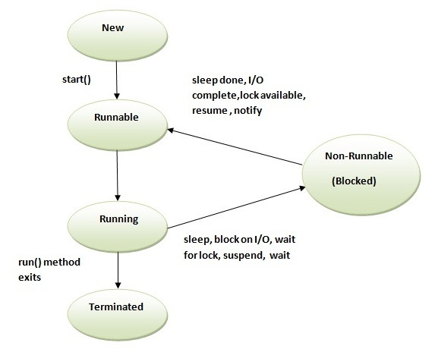
Thread Life Cycle in java

Slide 8
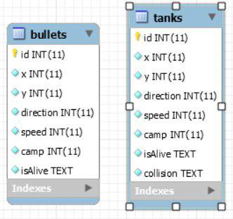
Database:

Slide 9
What we learned:
How to make 2D game
How to draw & animate graphics
How to use keyboard to play game
How to use database in game

Slide 10
Future work:
Replay last game
Create BD more tables save data
Create map with water, ice and wall (or 3D)
Networking game C/S

Slide 11
Conclusion:
“Great question. Any other questions ?”

